Slide 1
honeymoon
Aditya and Aditi
PPT for Event ID: 13
Date: 2025-01-31

Slide 2
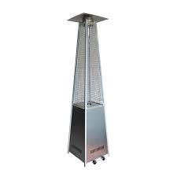
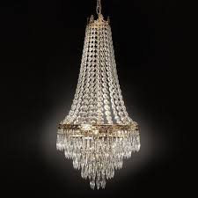
Category: Decor
Pyramid heater
Jhoomar
₹3000.00 x 10
₹2000.00 x 4

Slide 3
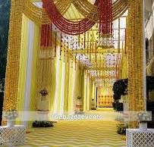
Category: Entrance
Haldi Entrance
₹30000.00 x 1

Slide 4

Category: Services
Russian Dancer
₹6000.00 x 20

Slide 5
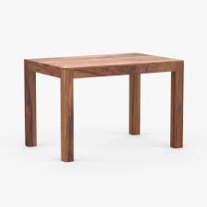
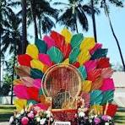
Category: Furniture
table
chair
₹200.00 x 20
₹500.00 x 4

Slide 6
Quotation Summary
Total Cost: ₹194000.00

